Slide 1

Quantum Finance: Pricing Financial derivatives using IBMQX
Applying: TEACHING, Challenge 12

Slide 2


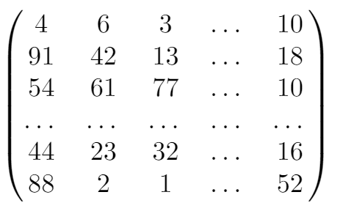


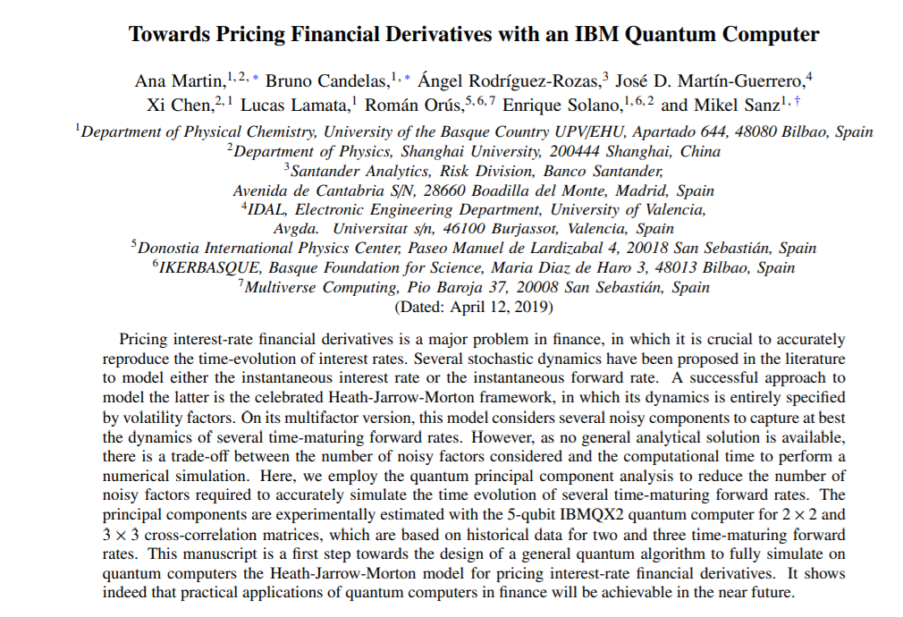
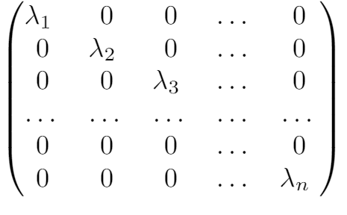
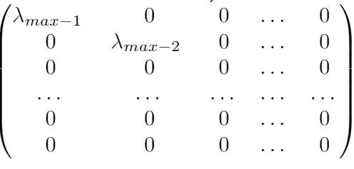
Problem Description
Pricing Financial derivatives
InnoLab Hackathon, Team 12
GIVEN RESOURCES:
Notes:
Un derivado financiero o instrumento derivado es un producto financiero cuyo valor se basa en el precio de otro activo.
→ Cosas que cotizan en bolsa dependiendo de otro.
Ver cuales son los más importantes

Slide 3
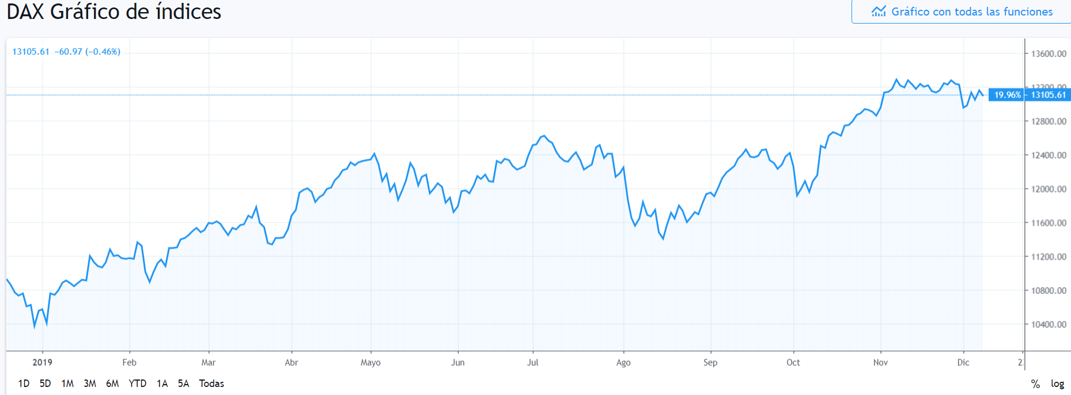
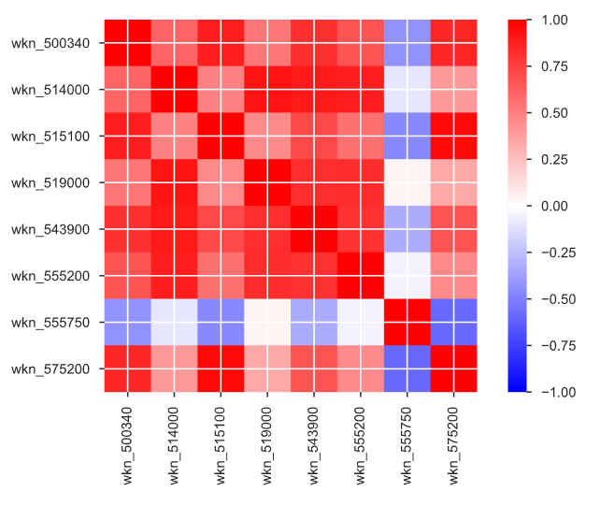
Data Exploration
Pricing Financial derivatives
InnoLab Hackathon, Team 12

Slide 4

How to effectively solve it using Quantum Computing?
Pricing Financial derivatives
InnoLab Hackathon, Team 12
Covariance Matrix
Quantum Gate
Eigenvector
Amplitude Estimation
Quantum Fourier

Slide 5
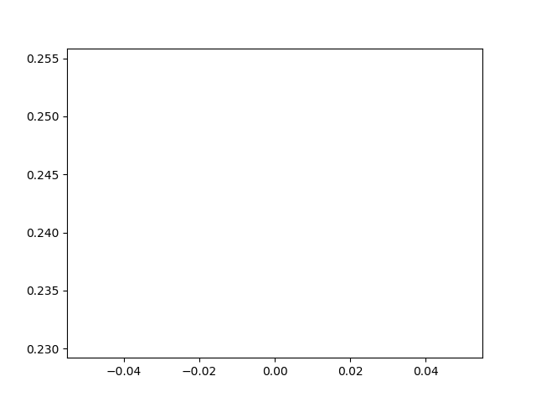
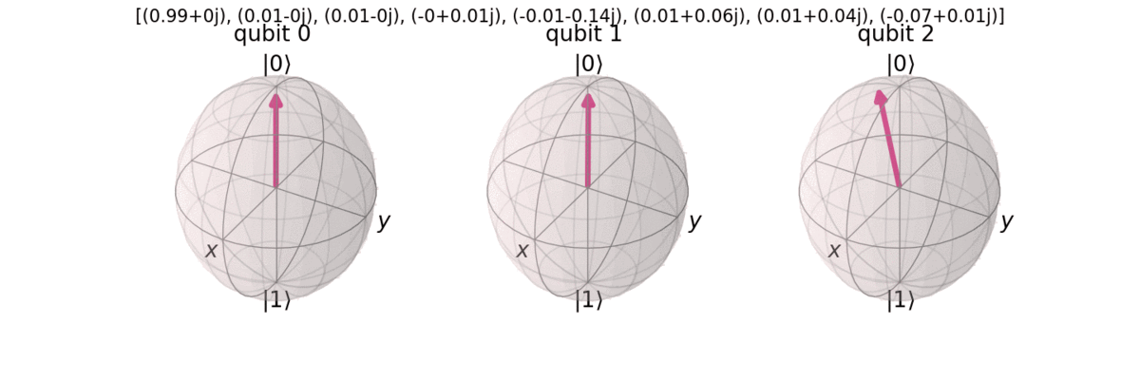
Our Solution
Pricing Financial derivatives
InnoLab Hackathon, Team 12
Coefficients of eigenvector:
Error:
Bloch sphere representation
Result state vector

Slide 6
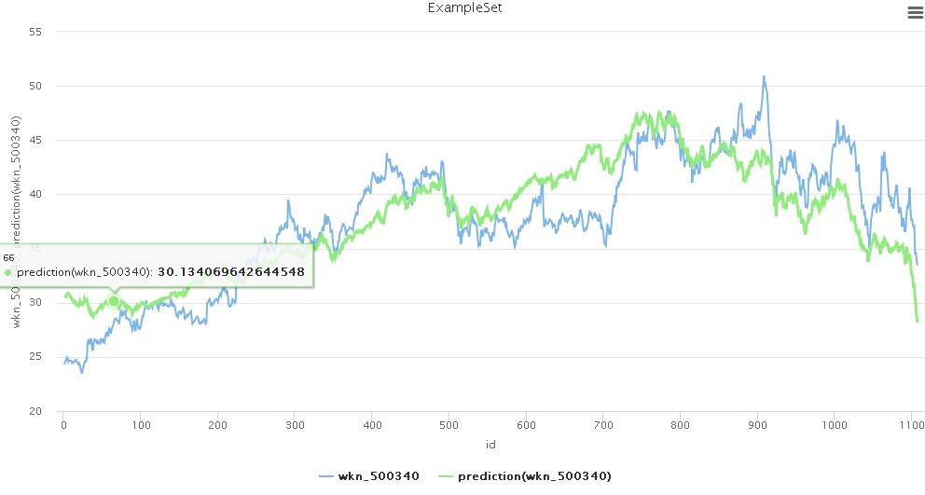
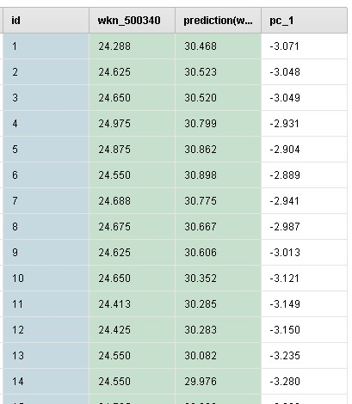
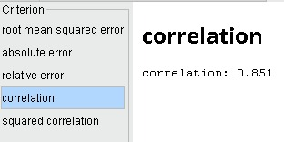
Forecast validation
Pricing Financial derivatives
InnoLab Hackathon, Team 12
Correlation: 0.851

Slide 7

Problems & Limitations
Pricing Financial derivatives
InnoLab Hackathon, Team 12
Improve efficiency while generating the unitary quantum gate from the covariance matrix
Noise: Decoherence time and Time relaxation due to the hardware
Statistical error: Drives us to iterate several time to avoid deviation error

Slide 8




Further Work
Pricing Financial derivatives
InnoLab Hackathon, Team 12
Combine results with HHL algorithm to predict data behaviour
Generalize it as a module
qPCA
PrincipalComponentsAnalysisAFactory
PrincipalComponentsAnalysisQFactory
Add it to Qiskit

Slide 9







Team
Pricing Financial derivatives
InnoLab Hackathon, Team 12
Frank Torres
Arturo Acuaviva
Ibon Reinoso
Aitor Moreno
Gabriel Grajea

Slide 10



Pricing Financial derivatives
InnoLab Hackathon, Team 12

